Slide 1

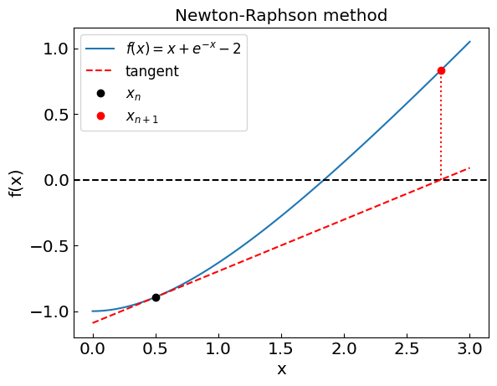
Computational Physics (PHYS6350)
Lecture 6: Non-linear equations and root-finding
Instructor: Volodymyr Vovchenko (vvovchenko@uh.edu)
Course materials: https://github.com/vlvovch/PHYS6350-ComputationalPhysics
Online textbook: https://vovchenko.net/computational-physics/

Slide 2
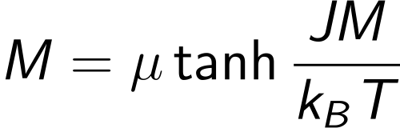
Non-linear equations
Suppose we have an equation f(x) = 0
We can evaluate f(x), but we do not know how to solve it for x
Examples:
Roots of high-order polynomials (physics example: Lagrange L₁ point)
Transcendental equations
e.g. magnetization equation
References:
Chapter 6 of Computational Physics by Mark Newman
Chapter 9 of Numerical Recipes Third Edition by W.H. Press et al.

Slide 3
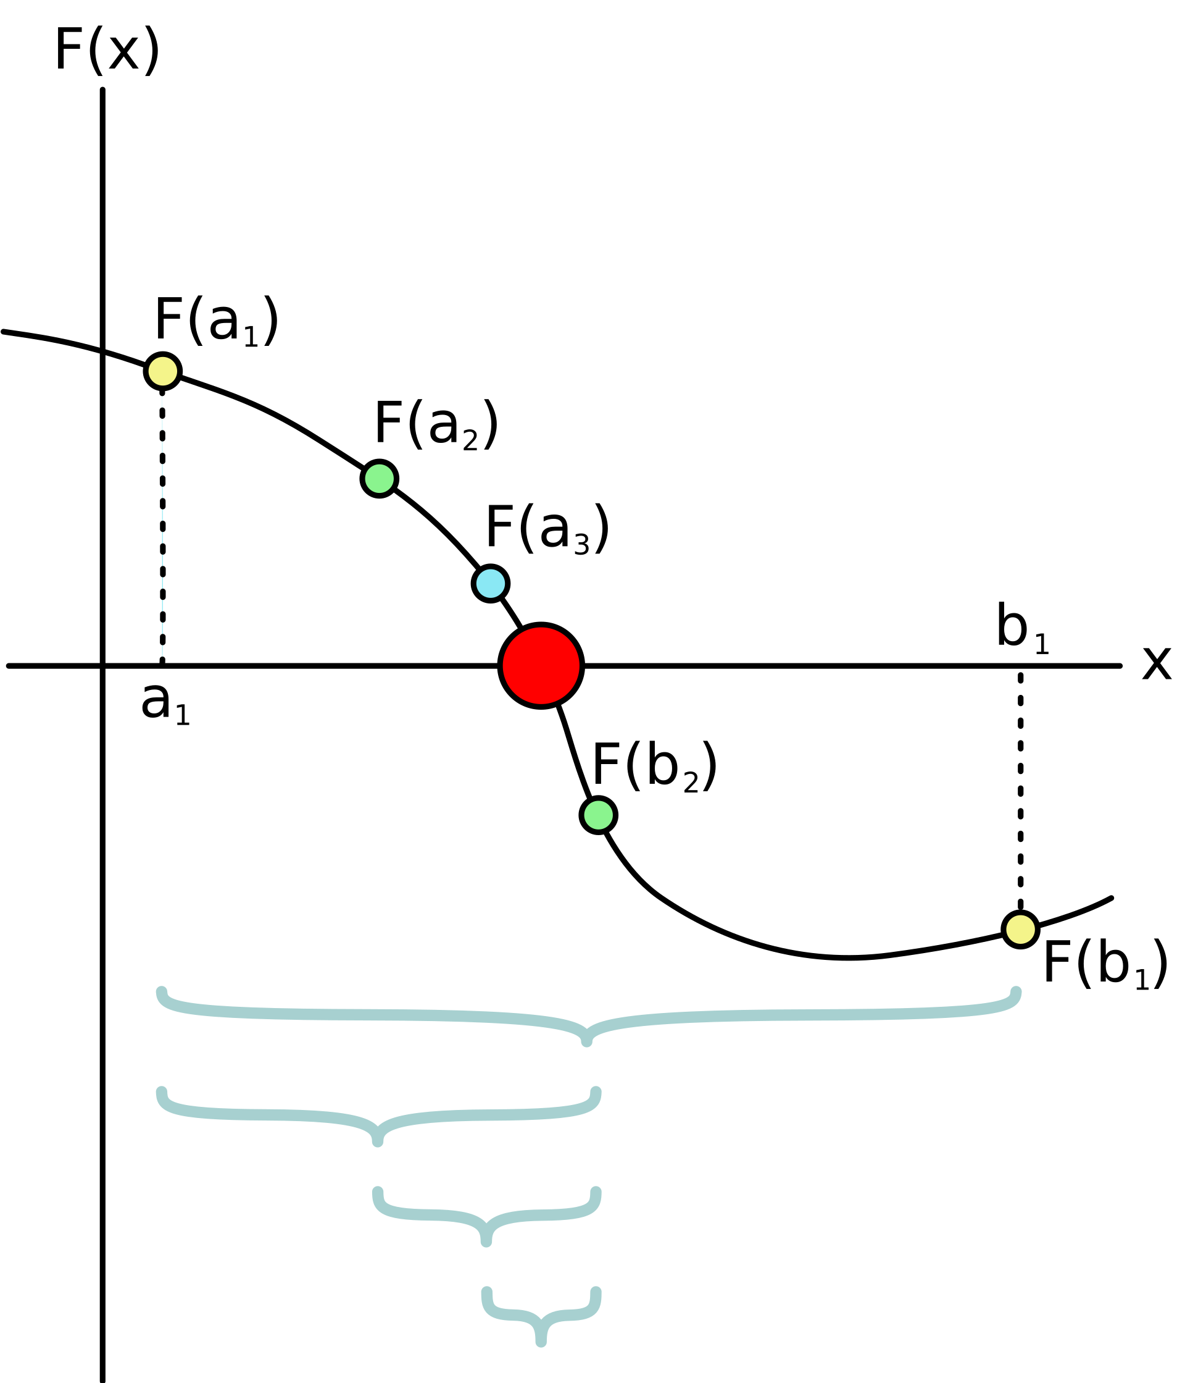
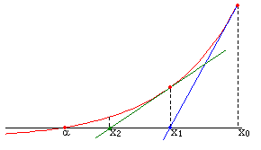
Root-finding techniques
Numerical root-finding method: iterative process to determine the root(s) of non-linear equation(s) to desired accuracy
Types:
Two-point (bracketing)
Bisection method
False position method
Local
Secant method
Newton-Raphson method (using the derivative)
Relaxation method
Multi-dimensional
Newton method
Broyden method
involves branching
© Wikipedia
no branching
© Wikipedia

Slide 4

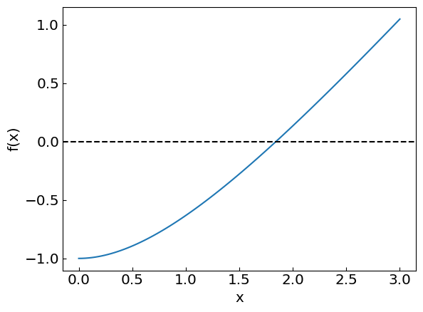
Non-linear equations
Consider an equation

Slide 5
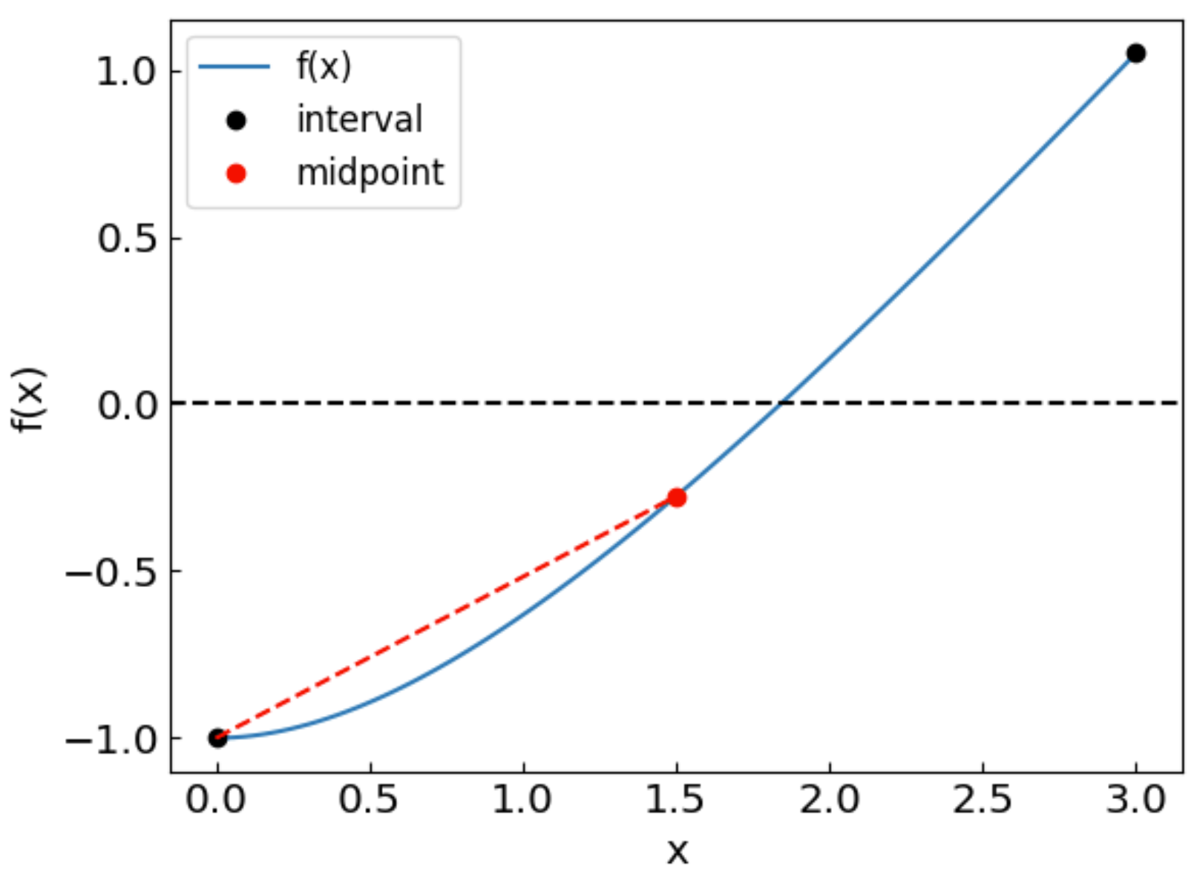
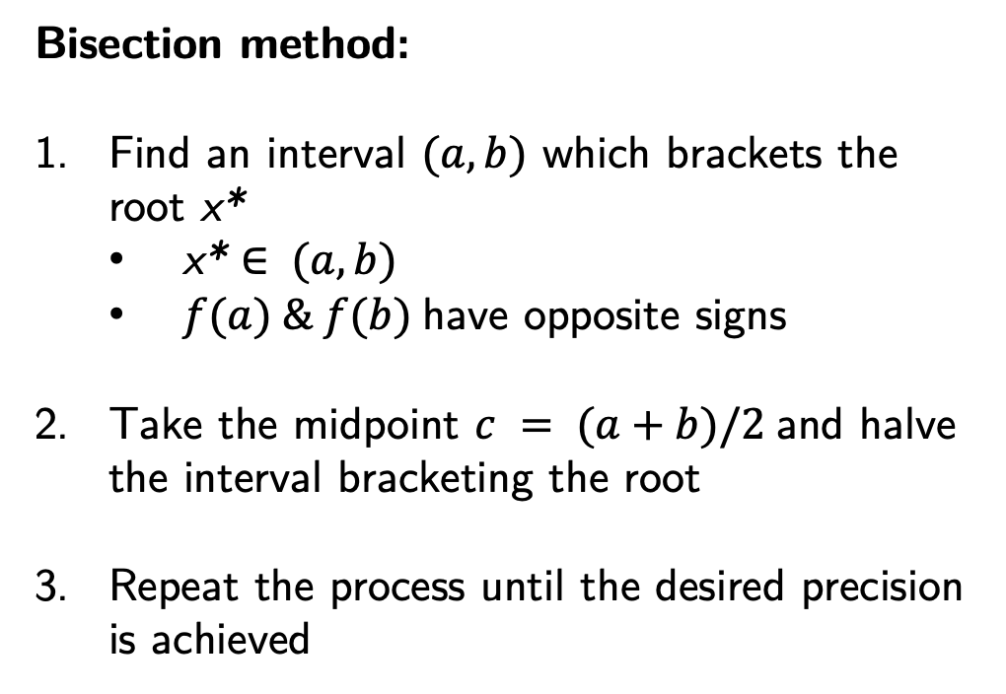
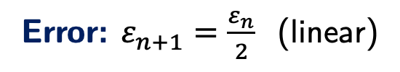
Bisection method
Bisection method:
Find an interval $(a,b)$ which brackets the root x*
x* $∈ (a,b)$
$f(a) \& f(b)$have opposite signs
Take the midpoint $c = (a+b)/2$and halve the interval bracketing the root
Repeat the process until the desired precision is achieved
Error: $ε_{n+1}=\frac{ε_{n}}{2}$ (linear)
Method is guaranteed to converge to the root
The error is halved at each step (“linear” convergence)

Slide 6
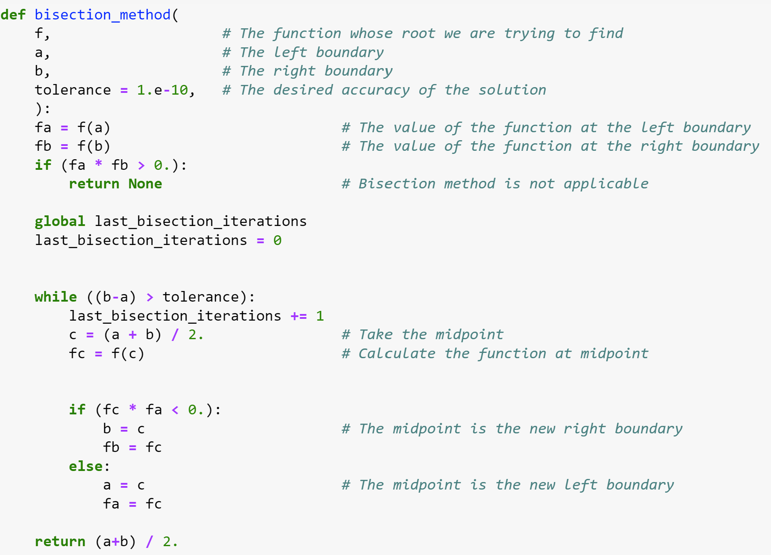
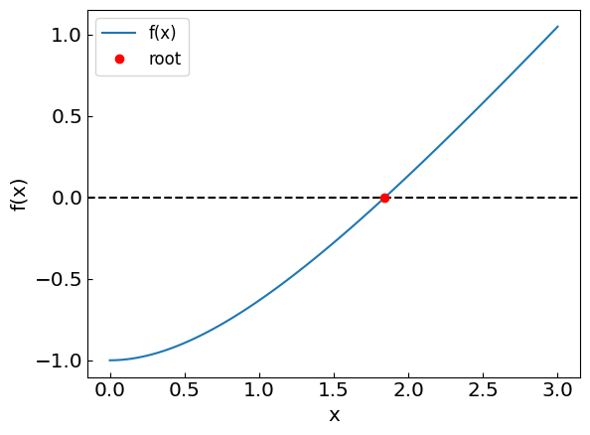
Bisection method

Slide 7
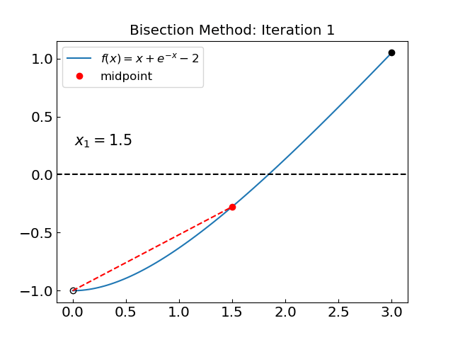
Bisection method: how the iterations look like

Slide 8
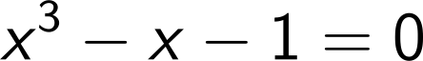
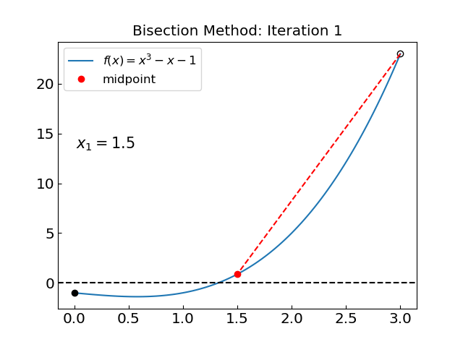
Bisection method: another example
Let us consider another equation:
35 iterations in both cases

Slide 9
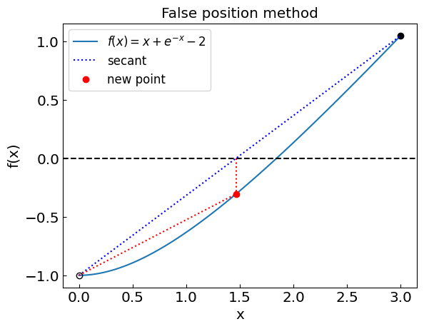
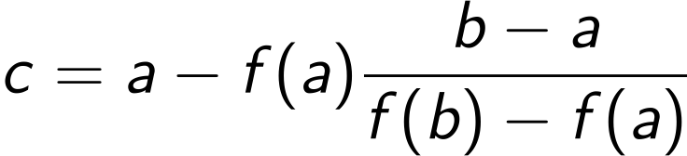
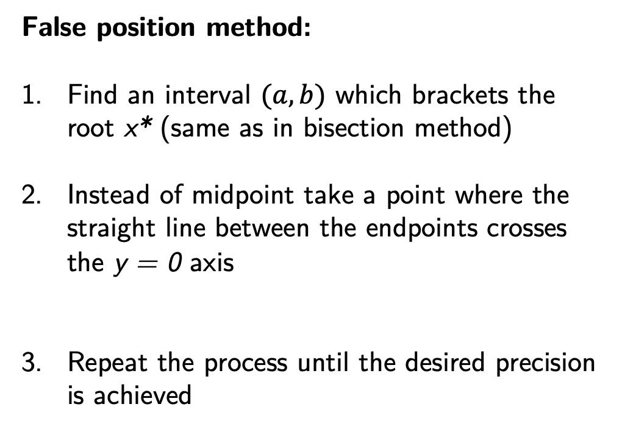

False position method
False position method:
Find an interval $(a,b)$ which brackets the root x* (same as in bisection method)
Instead of midpoint take a point where the straight line between the endpoints crosses the y = 0 axis
Repeat the process until the desired precision is achieved
Error: $ε_{n+1}≈Cε_{n}$ (linear)
Method is guaranteed to converge to the root
“Linear” convergence; typically faster than bisection, but not always (see example further)

Slide 10
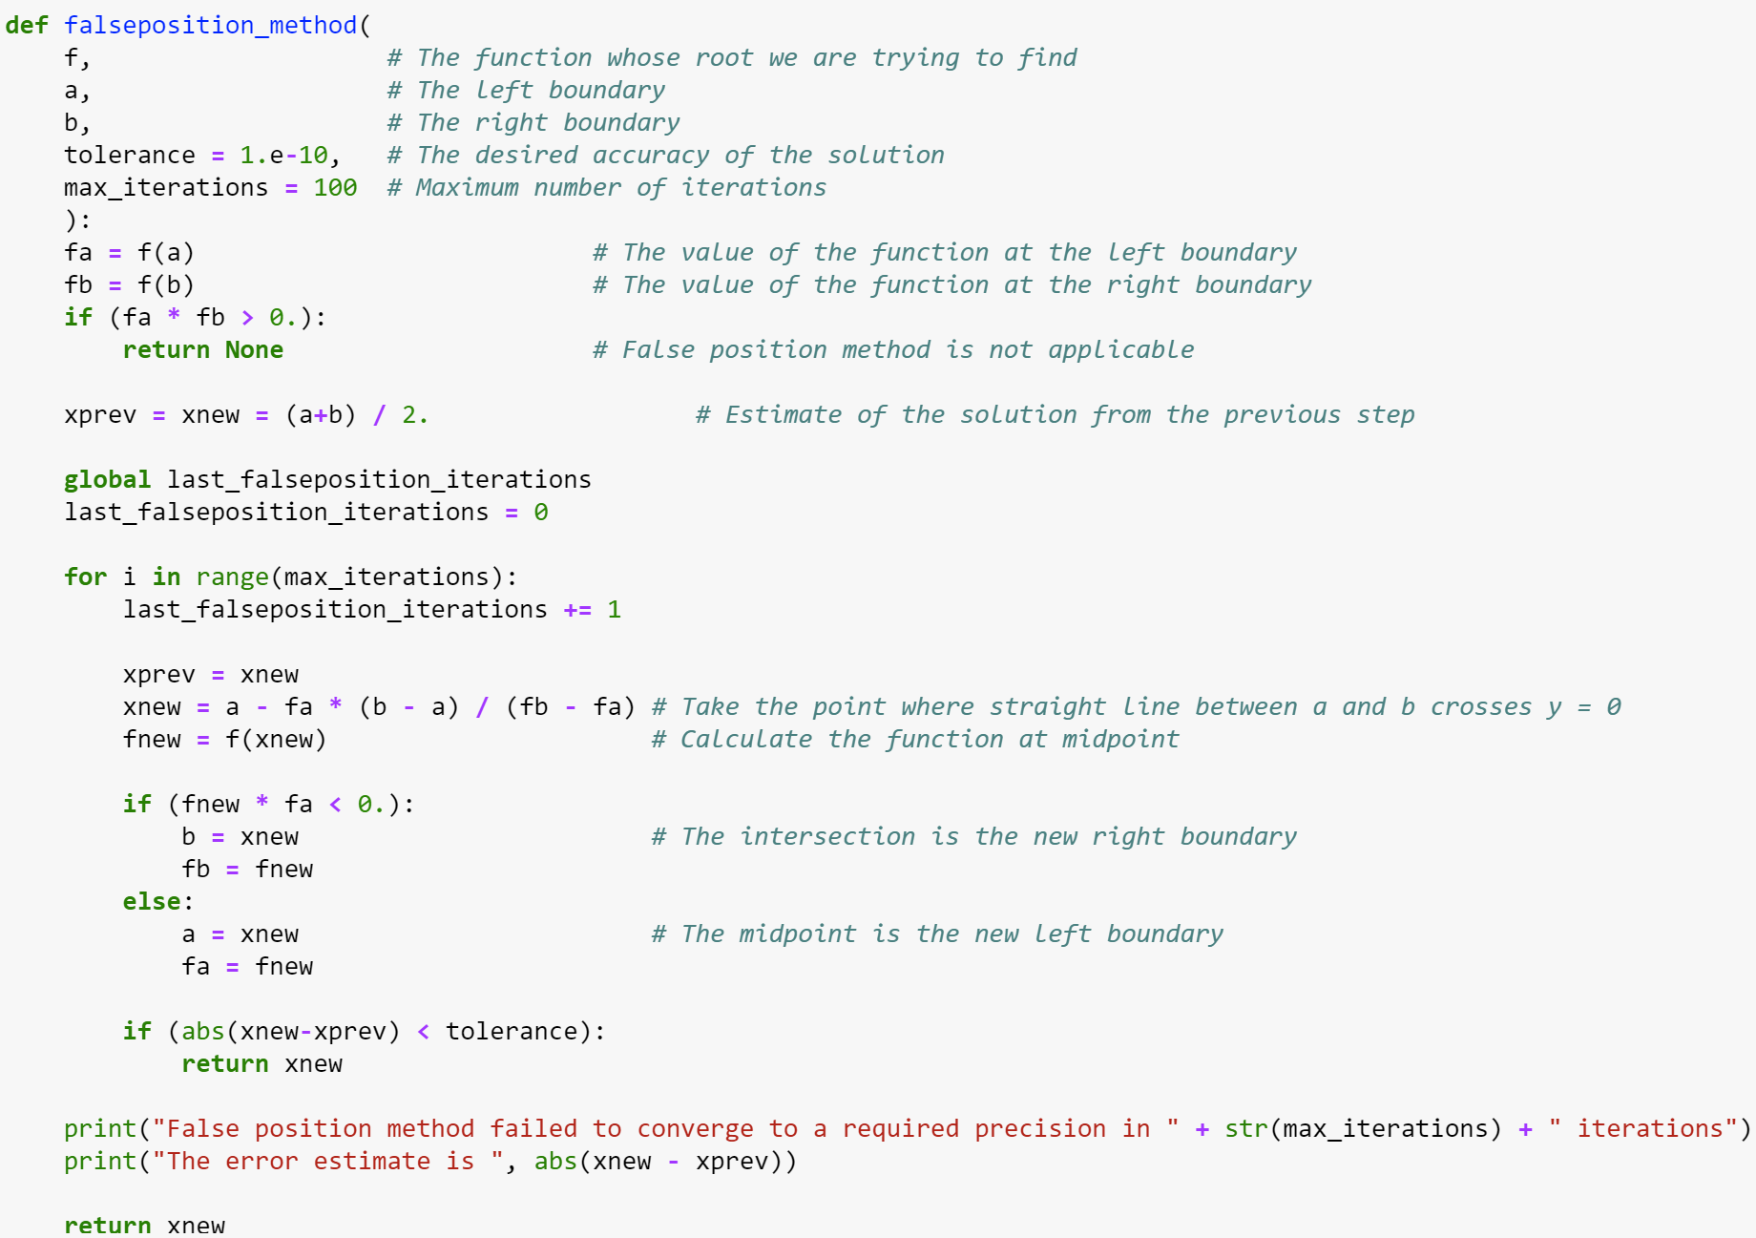
False position method

Slide 11
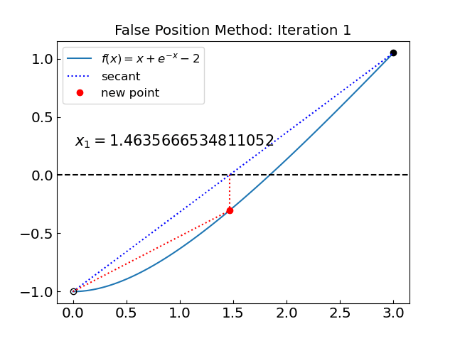
False position method

Slide 12
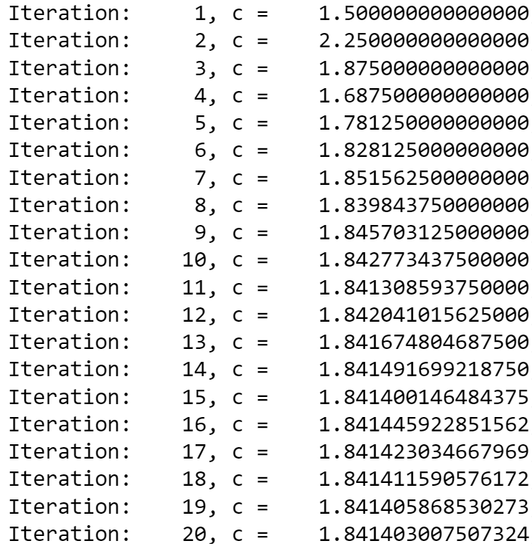
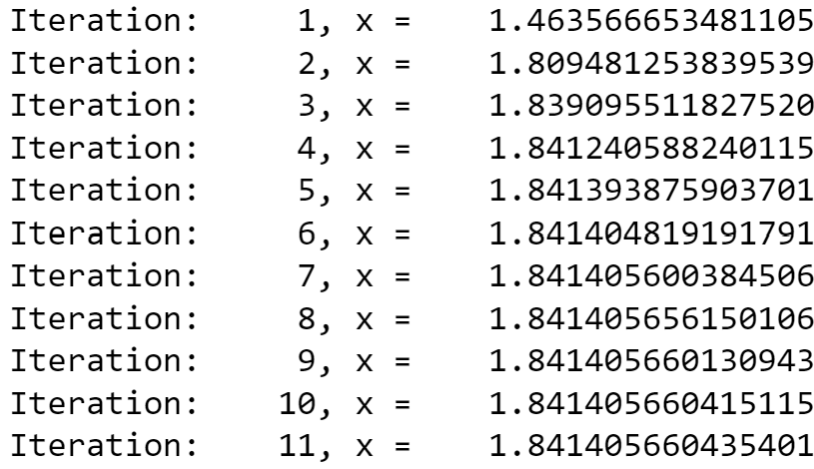
False position vs bisection (to 10 decimal digits)
Bisection method:
False position method:
…

Slide 13
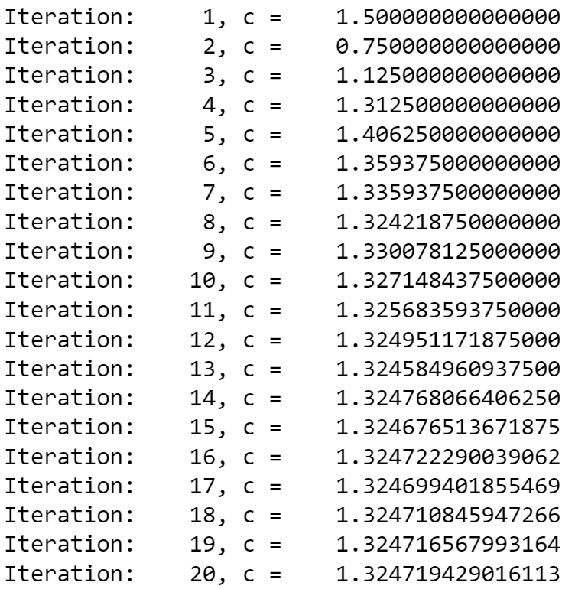
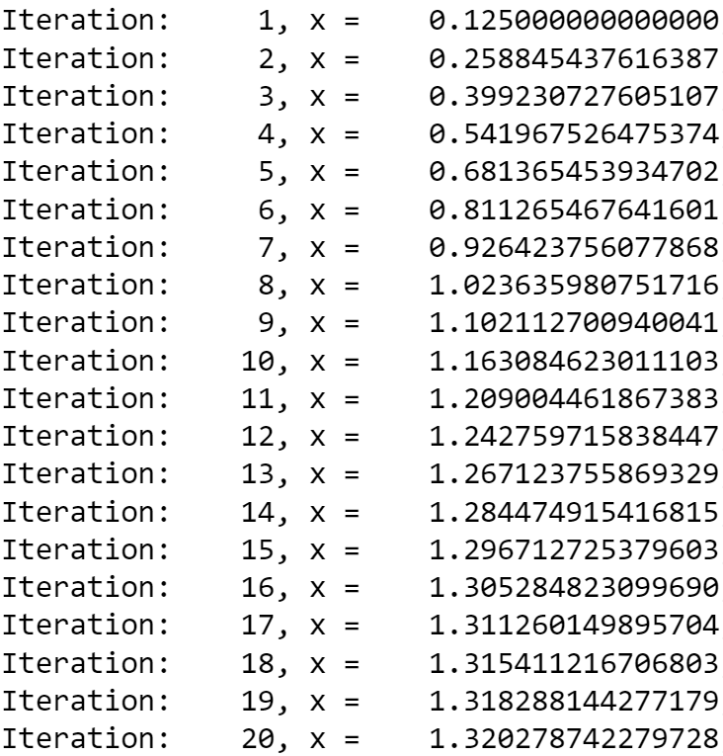
False position vs bisection: not always clear who wins
Bisection method:
False position method:
…
…

Slide 14
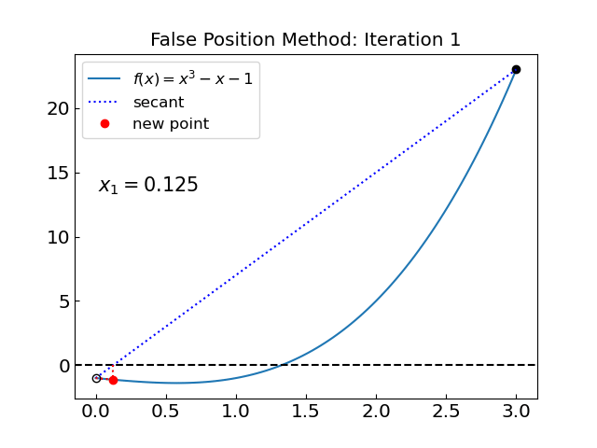
False position vs bisection: not always clear who wins
Bisection method:
False position method:
More advanced methods combine the two and add other refinements*
Ridders’ method
Brent method
final project idea(?)
see chapters 9.2, 9.3 of Numerical Recipes Third Edition by W.H. Press et al.

Slide 15
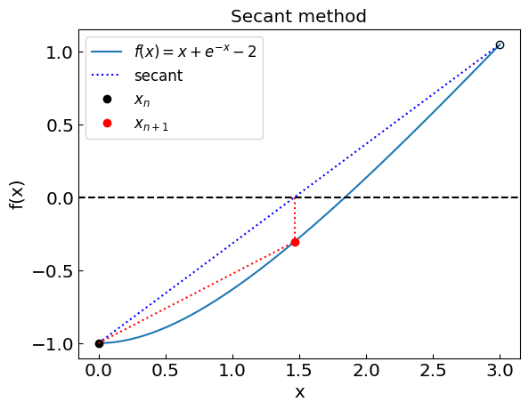
Secant method
Secant method: same as false position, except the interval need not bracket the root
Always uses the last two points, no branching (if-statement) involved in the procedure
vs
Typically, “superlinear” convergence occurs when the algorithm is effective. However, it can still be slower than bisection or may not converge at all (e.g., the secant method may be parallel to the x-axis).

Slide 16
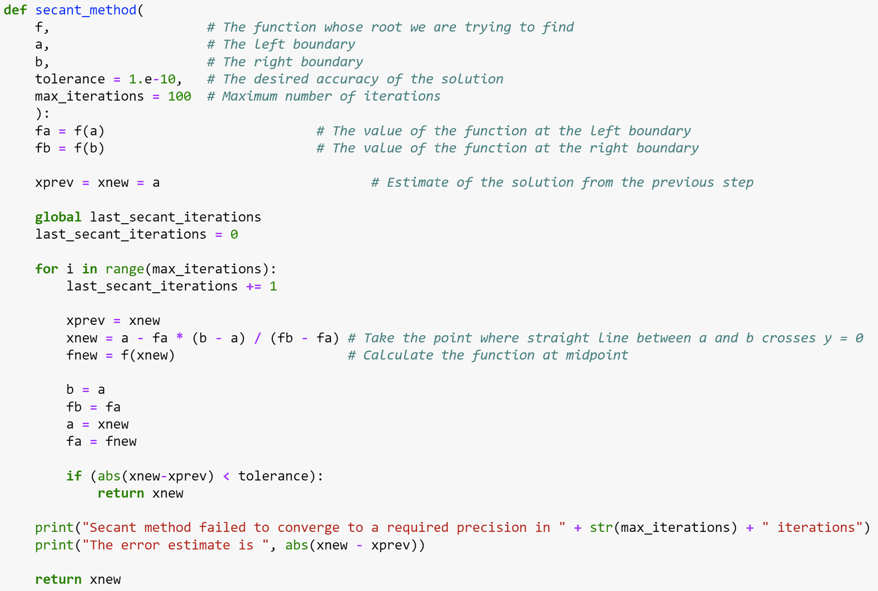
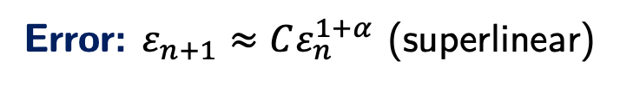
Secant method
Error: $ε_{n+1}≈Cε_{n}^{1+α}$ (superlinear)

Slide 17
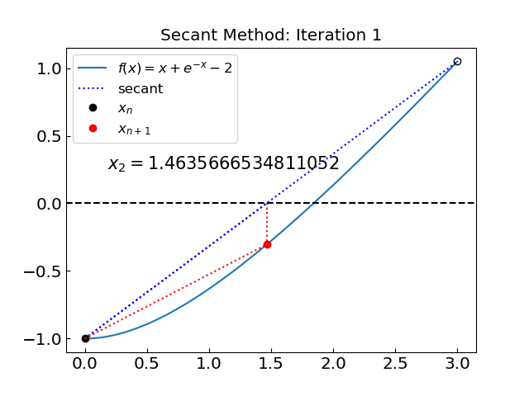
Secant method

Slide 18
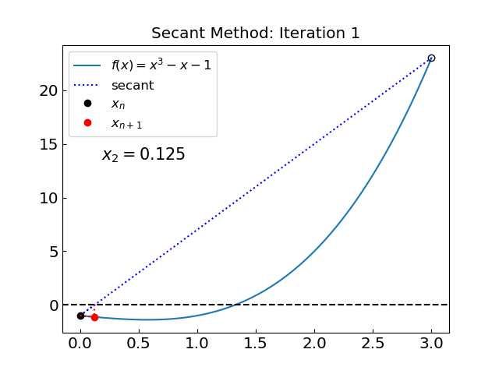
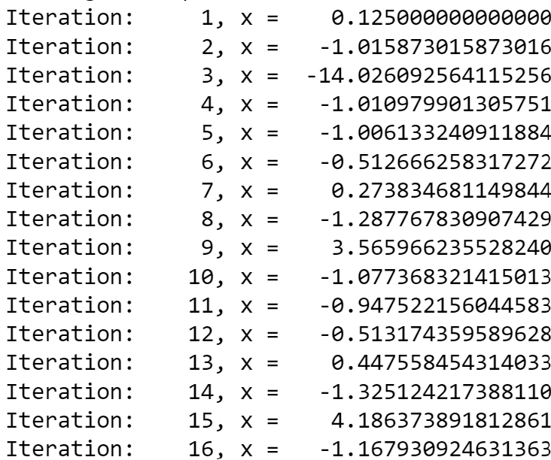
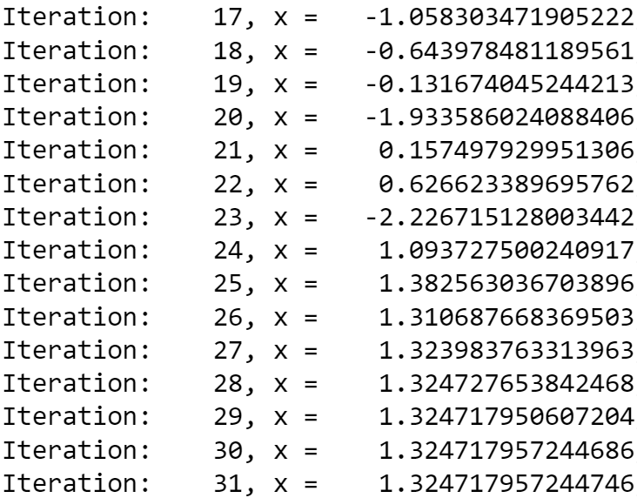
Secant method
The secant method is not assured to converge since it does not bracket the root.
In this particular example, it eventually succeeded after initially diverging.

Slide 19
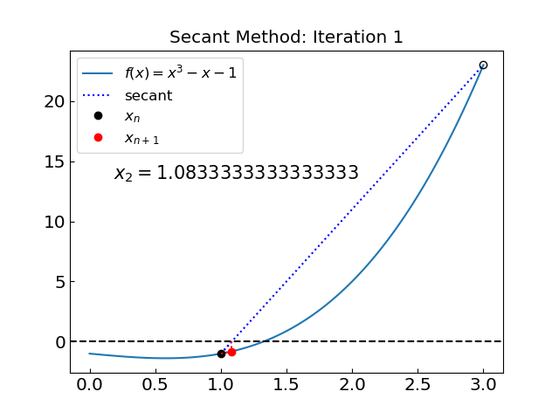
Secant method: Choice of interval
Choose the initial interval as (1,3) instead of (0,3)
If possible, select the initial interval as close as possible to the root

Slide 20
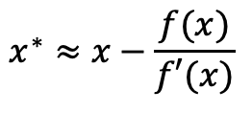
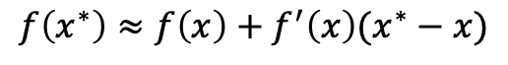
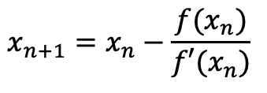
Newton-Raphson method
Newton-Raphson method:
Local method (uses only the current estimate to get the next one)
Requires the evaluation of the derivative (tangent)
Not always available or easy to compute
Idea: Assume that a given point x is close to the root x* [f(x*) = 0]
Then (Taylor theorem)
$$f\left(x^{∗}\right)≈f\left(x\right)+f^{′}\left(x\right)(x^{∗}−x)$$
and since f(x*) = 0 we have
$$x^{∗}≈x−\frac{f(x)}{f′(x)}$$
Iterative procedure:
$$x_{n+1}=x_{n}−\frac{f(x_{n})}{f′(x_{n})}$$
starting from an initial guess x₀

Slide 21

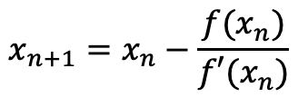
Newton-Raphson method
$$x_{n+1}=x_{n}−\frac{f(x_{n})}{f′(x_{n})}$$
Error: $ε_{n+1}≈Cε_{n}^{2}$ (quadratic)
“Quadratic” convergence when works
However, when we are close to $f’ = 0$, we have a problem

Slide 22
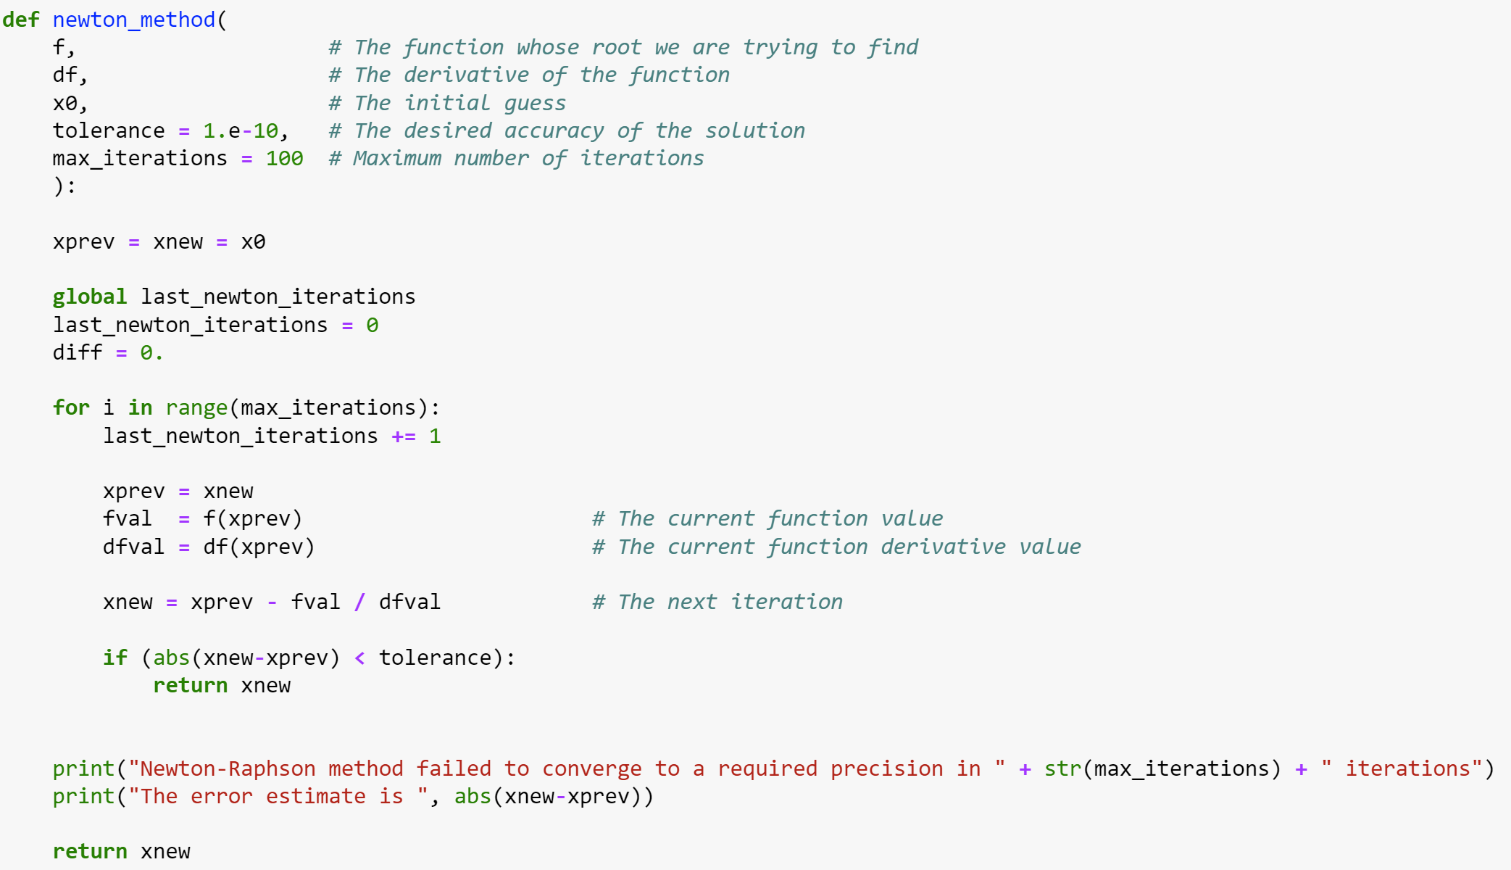
Newton-Raphson method

Slide 23
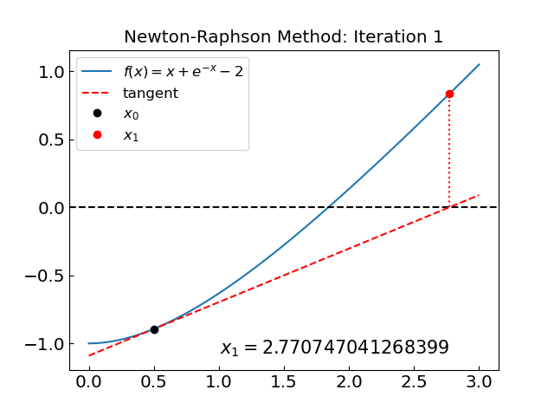
Newton-Raphson method

Slide 24
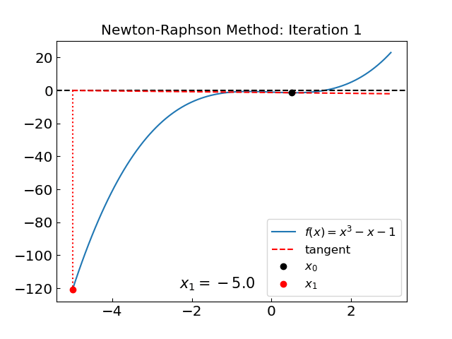
Newton-Raphson method: issues
Similar issue as with the secant method; the reason: $f′ = 0$ at x = 0.577…

Slide 25
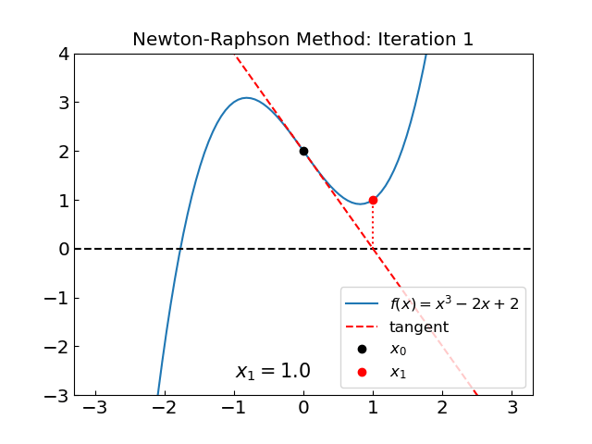
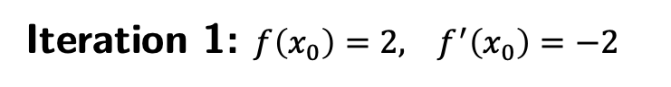
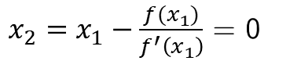
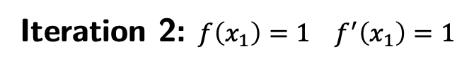
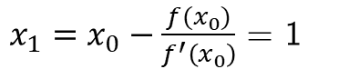
Newton-Raphson method: issues
Try finding the root of $f\left(x\right)=x^{3}−2x+2$ with an initial guess of $x_{0}=0$
Iteration 1: $f\left(x_{0}\right)=2, f^{′}\left(x_{0}\right)=−2$
$x_{1}=x_{0}−\frac{f(x_{0})}{f^{′}\left(x_{0}\right)}$ = 1
Iteration 2: $f\left(x_{1}\right)=1 f^{′}\left(x_{1}\right)=1$
$x_{2}=x_{1}−\frac{f(x_{1})}{f^{′}\left(x_{1}\right)}$ = 0
We are back to x₀!
The main issue is, again, we have points with $f′ = 0$in the neighborhood

Slide 26
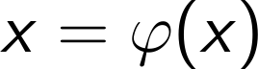
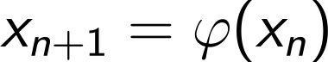
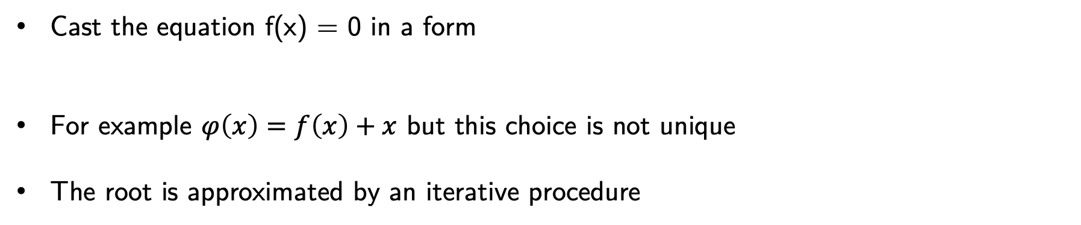
Relaxation method
Cast the equation f(x) = 0 in a form
For example $φ\left(x\right)=f\left(x\right)+x$ but this choice is not unique
The root is approximated by an iterative procedure
Convergence criterion:

Slide 27
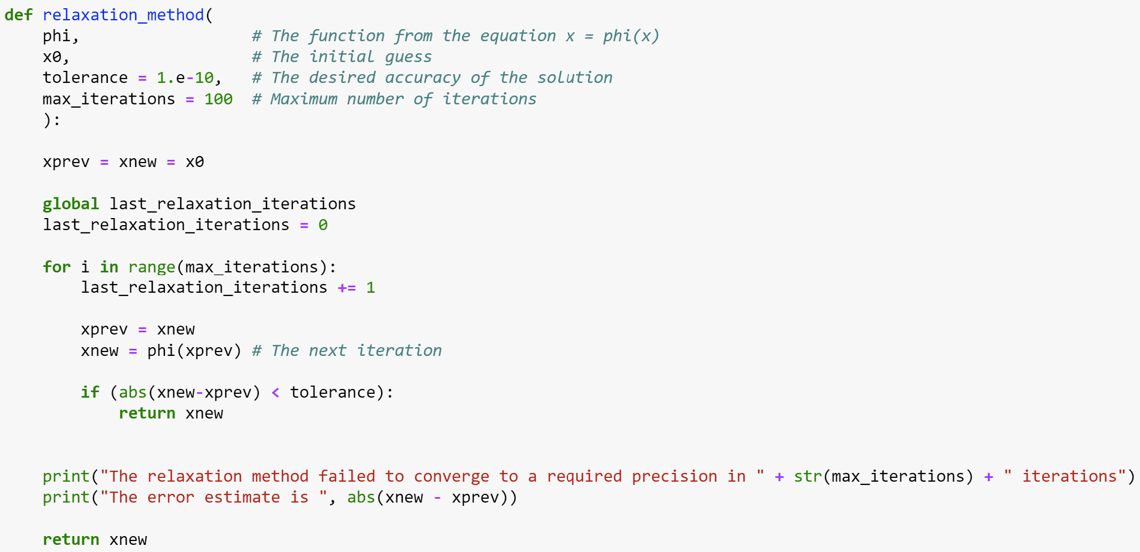
Relaxation method

Slide 28
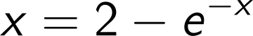
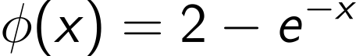
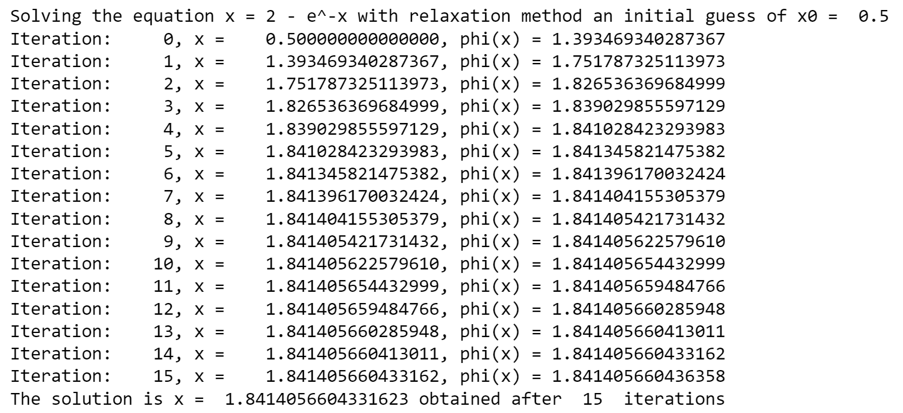

Relaxation method
as
i.e.
Starting with $x_{0}$=0.5 we have
Not as fast as Newton-Raphson but does not require evaluation of the derivative

Slide 29





Relaxation method
as
i.e.
Starting with $x_{0}$=0 we have
Divergent!
violated [try to come up with a better choice of $φ(x)$?]
Reason:

Slide 30




Summary

Slide 31

Summary
Bracketing methods
Bisection method:
Guaranteed to converge with a fixed rate
Need to bracket the root
False position method:
Guaranteed to converge
Can be faster than bisection but not always
Need to bracket the root
Local method
Secant method:
Typically faster than bisection/false position
May not always converge
Does not need derivative
Newton-Raphson method:
Very fast when converges
Can be sensitive to initial guess
May not converge if $f′(x)=0$
Requires evaluation of the derivative at each step
Relaxation method:
Simple to implement
Does not require derivative
Often does not converge

Slide 32

Summary
Method | Convergence Rate | Requires Derivative? | Guaranteed to Converge?
Bisection | Linear O($1/2^{n}$) | ❌ | ✅
False Position | Linear (but variable) | ❌ | ✅
Secant | Superlinear O($e^{−(1+α)n}$) | ❌ | ❌
Newton-Raphson | Quadratic O($e^{−2n}$) | ✅ | ❌
Relaxation | Variable | ❌ | ❌

